Slide 1

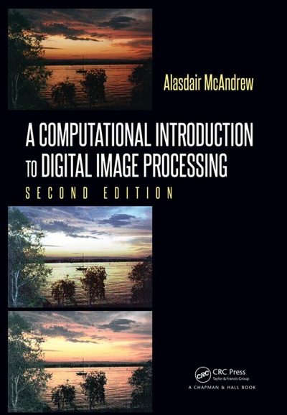
Chapter 4
Point Processing

Slide 2

Image Processing Operations
3 Classes
Transforms: The entire image is processed as a single large block.
Neighborhood processing: Change the value of a given pixel based on a small neighborhood of pixels around the given pixel.
Point operations: Change the value of a pixel without any knowledge of surrounding pixels.

Slide 3
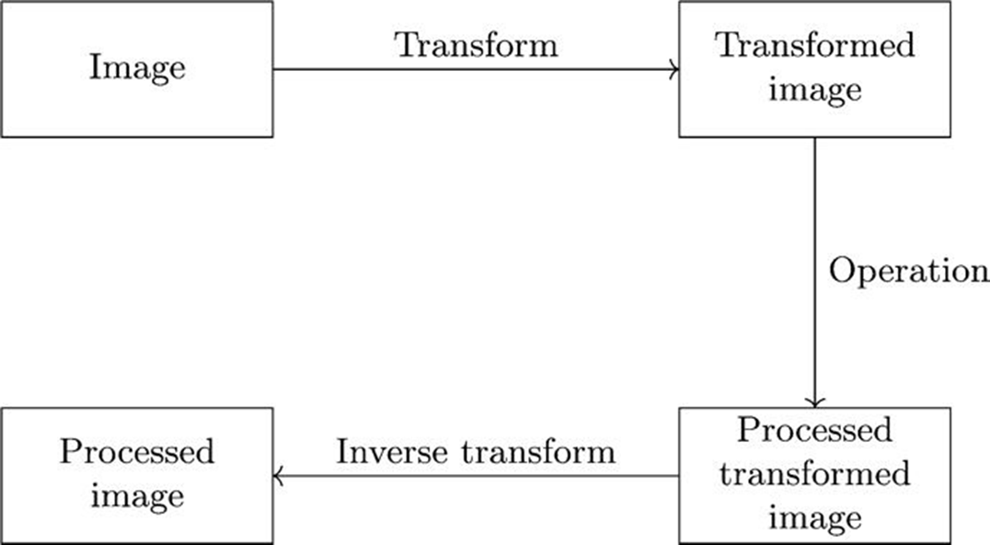
Image Processing Operations
Figure 4.1: Schema for transform processing

Slide 4
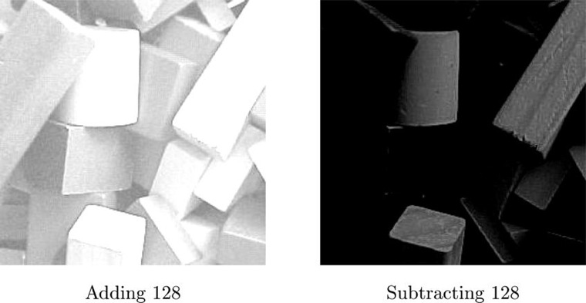
Arithmetic Operations (+ -)
Figure 4.4: Arithmetic operations on an image: adding or subtracting a constant

Slide 5
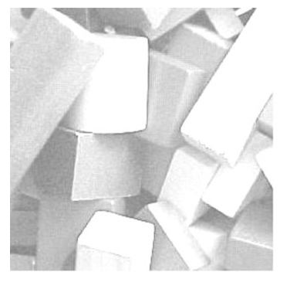
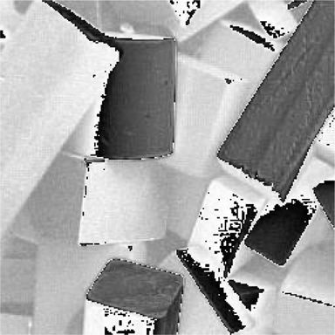
Arithmetic Operations (+ -)
Adding 128 to an image in
MatLab/Octave
Adding 128 to an image in Python
Why?

Slide 6
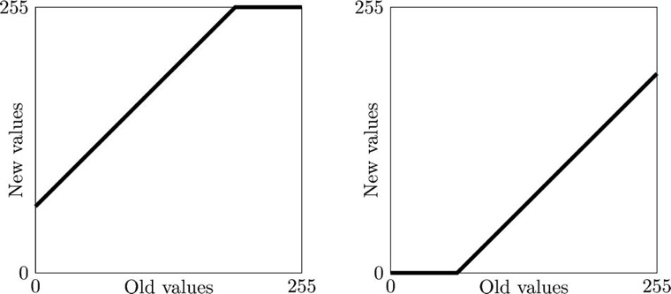
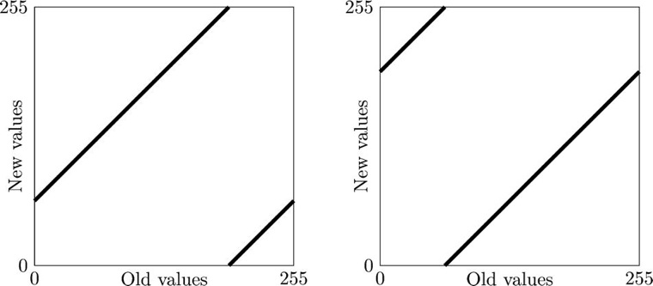
Adding and subtracting a constant in Matlab/Octave
Adding and subtracting a constant in Python

Slide 7
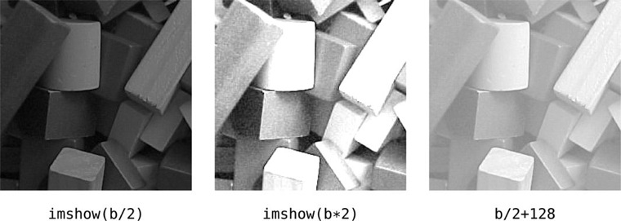

Arithmetic Operations (* /)
Figure 4.7: Arithmetic operations on an image: multiplication and division
Compare the results of darkening using division by two and subtraction by 128.
Which is clearer?
Why?
When subtracting 128, all pixels values <= 128 become zero.

Slide 8
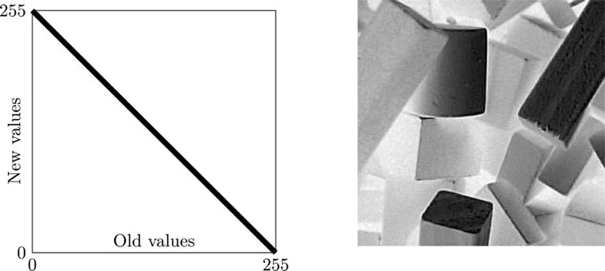
Complementation
Image complementation: 255-b
Effect of Complementation is called solarization

Slide 9
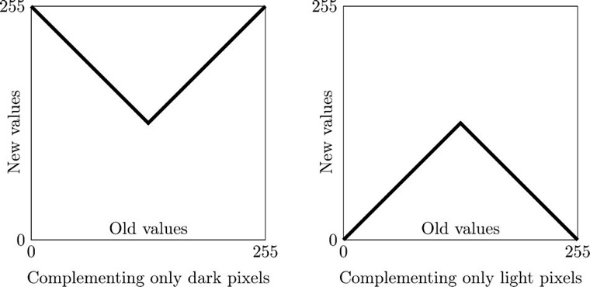
Complementation
Part Complementation

Slide 10
Complementation
Grayscale complementation:
Binary complementation:

Slide 11
Histograms
A Histogram is a graphical representation of the distribution of numerical data.
Histogram of Gray Levels (Grayscale image)
Dark image
Gray levels clustered at lower end (closer to black, 0)
Bright image
Gray levels clustered at upper end (closer to white, 255)
Well contrasted
Gray levels spread out over the range

Slide 12
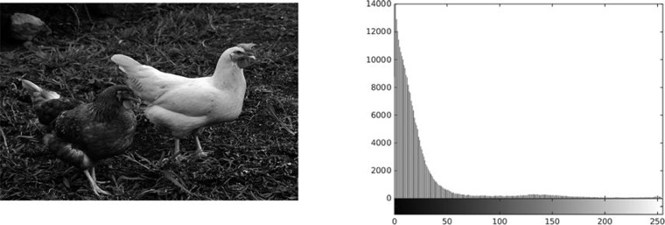
Histograms
Figure 4.10: The image chickens.png histogram
From this histogram, what do you expect about the picture?

Slide 13
Histograms
Figure 4.10: The image chickens.png
Dark and poorly contrasted
Histogram clustered at low end
Were you right?

Slide 14
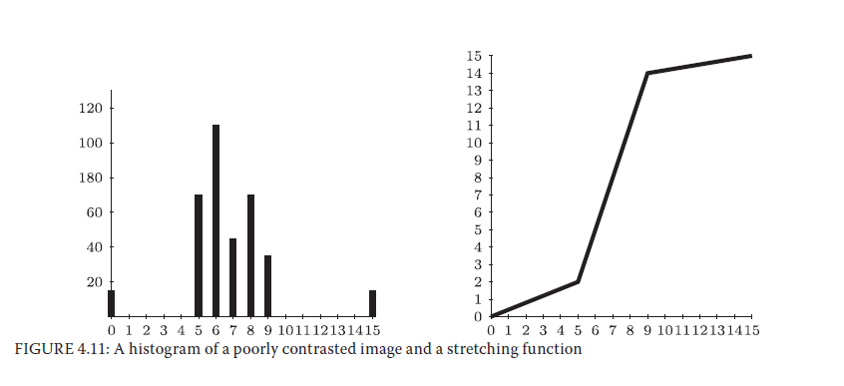
Histograms
Histogram stretching (Contrast Stretching)
Simple Example: Gray levels in range 5-9 are stretched to levels ranging from 2-14.

Slide 15
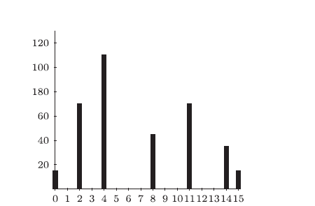
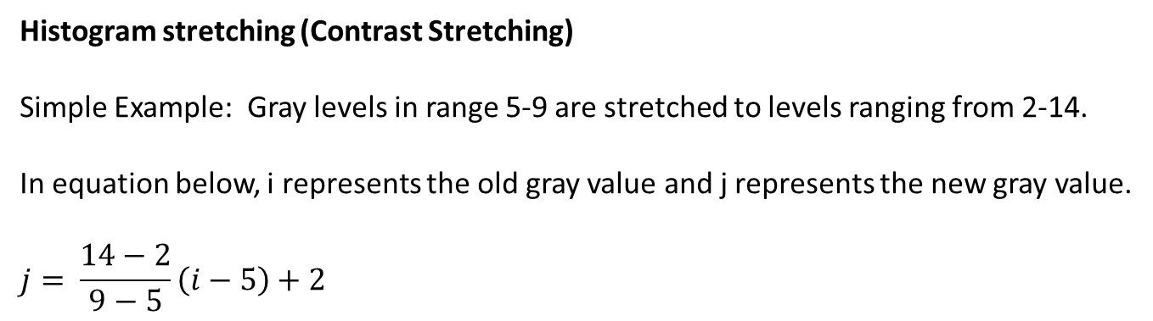
Histograms
Histogram stretching (Contrast Stretching)
Simple Example: Gray levels in range 5-9 are stretched to levels ranging from 2-14.
In equation below, i represents the old gray value and j represents the new gray value.
$$j= \frac{14−2}{9−5}\left(i−5\right)+2$$
i 5 6 7 8 9
j 2 5 8 11 14

Slide 16
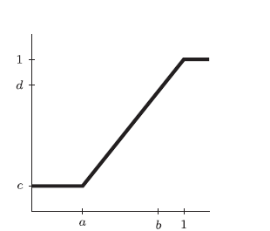
Histograms
MATLAB/Octave use imadjust to perform histogram stretching:
imadjust(im, [a,b], [c,d], gamma (optional))
a, b, c, and d must be between 0 & 1, but will be automatically converted if necessary.

Slide 17
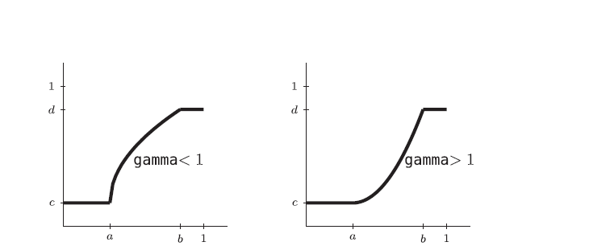
Histograms
MATLAB/Octave use imadjust to perform histogram stretching:
imadjust(im, [a,b], [c,d], gamma (optional))
Optional gamma value changes the shape of the function from default (linear).

Slide 18
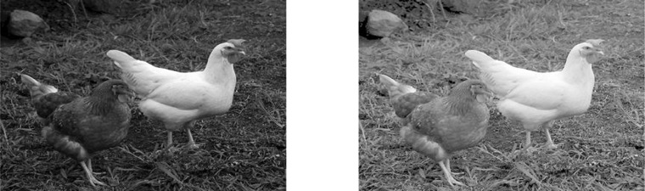
Histogram Stretching
Another look at the chickens image...AFTER histogram stretching.
Figure 4.15: The chickens image with different adjustments with the gamma value
Finding the correct gamma value can require some trial and error

Slide 19
Try it Out
>> ch = imread('chickens.png');
>> imshow(ch);
>> ch1 = imadjust(ch, [], [], 0.25);
>> ch2 = imadjust(ch, [], [], 0.5);
>> ch3 = imadjust(ch, [], [], 2);
>> imshow(ch1);
>> imshow(ch2);
>> imshow(ch3);

Slide 20
Histogram Equalization
Main Idea
Change histogram so that it is more uniform
Completely AUTOMATIC procedure
Stretching requires user input

Slide 21
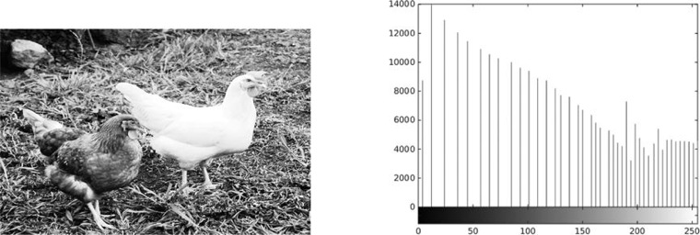
Histogram Equalization
Let’s take a look at those chickens...One more time
Figure 4.20: The histogram of Figure 4.10 after equalization

Slide 22
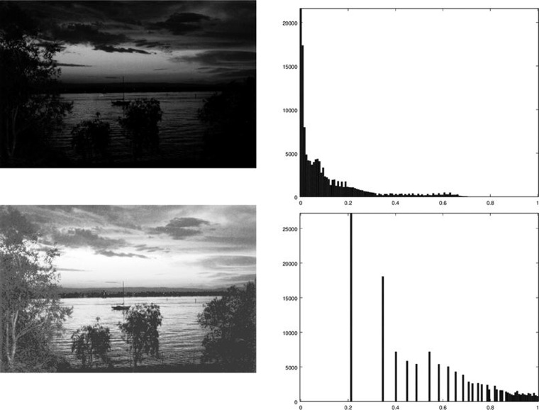
Histogram Equalization
Figure 4.21: The sunset image and its histogram, with equalization

Slide 23
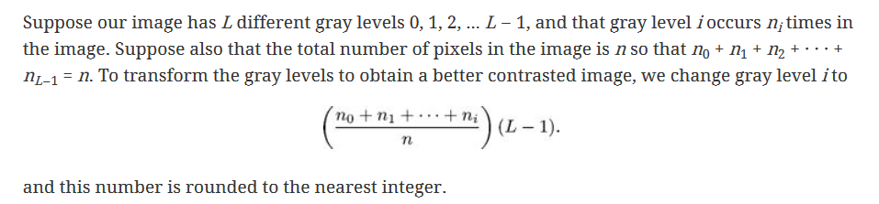
Histogram Equalization

Slide 24
Try it Out
>> ch = imread('chickens.png');
>> imshow(ch), figure, imhist(ch);
error: colorbar: LOC specification must occur as final argument
error: called from
colorbar at line 116 column 11
imhist at line 165 column 5
>> ch1 = histeq(ch);
>> imshow(ch1), figure, imhist(ch1);
error: colorbar: LOC specification must occur as final argument
error: called from
colorbar at line 116 column 11
imhist at line 165 column 5
Error in Octave "…this bug is still there in the latest released Octave Version 4.4. "
May not occur in MATLAB

